Slide 1

DBMS PROJECT
TAX CALCULATION MANAGEMENT SYSTEM
Submitted by,
Anubhav Agrawal (21CSB0F36)
Abhinash Kumar Sah (21CSB0F37)

Slide 2
CONTENTS
PROBLEM STATEMENT
SOLVING ASSUMPTION
ER (ENTITY RELATIONSHIP) MODEL
ASSUMED TABLES WITH FUNCTIONAL DEPENDENCIES AND NORMALIZED FORMS
CREATION OF TABLES
RELATIONAL DATABASE MODEL
INSERTION OF VALUES INTO TABLE
SQL QUERIES AND USE OF JOIN
CONCLUSION

Slide 3
PROBLEM STATEMENT
We created a database model where the agents will be there with different credentials who will be managing the tax and other details of the users. Thus, we will be creating many to many relationship between them.
Then, every user will be having a occupation or we can read it as one occupation is done by one user creating one to one relationship between them. Now, here we will get the income data of the users.
Again, we here try to remind users the exemptions that they can get in tax system if they have taken some loan or insurance premium and one occupation holding person can have one exemption. Thus, the tax payer now pays the tax amount after deducting the exemption amount from the table and thus we get the final data.

Slide 4
SOLVING ASSUMPTION
We created a database model where we have made firstly the ER diagram to understand the way we will proceed to lead our work done in a functional manner with proper output strategy.
Then, we created a Relational Database Model where we created different table for each tuple and we define the attributes inside it where we also consider primary key, foreign key and many other relating attribute. Now, we inserted different values in it and created a super model where we now access the values of what we require.
We also ran some of the SQL queries to re-assure the working of our database model and then we have completed the task of how we created this database system on TAX calculation management system.

Slide 5
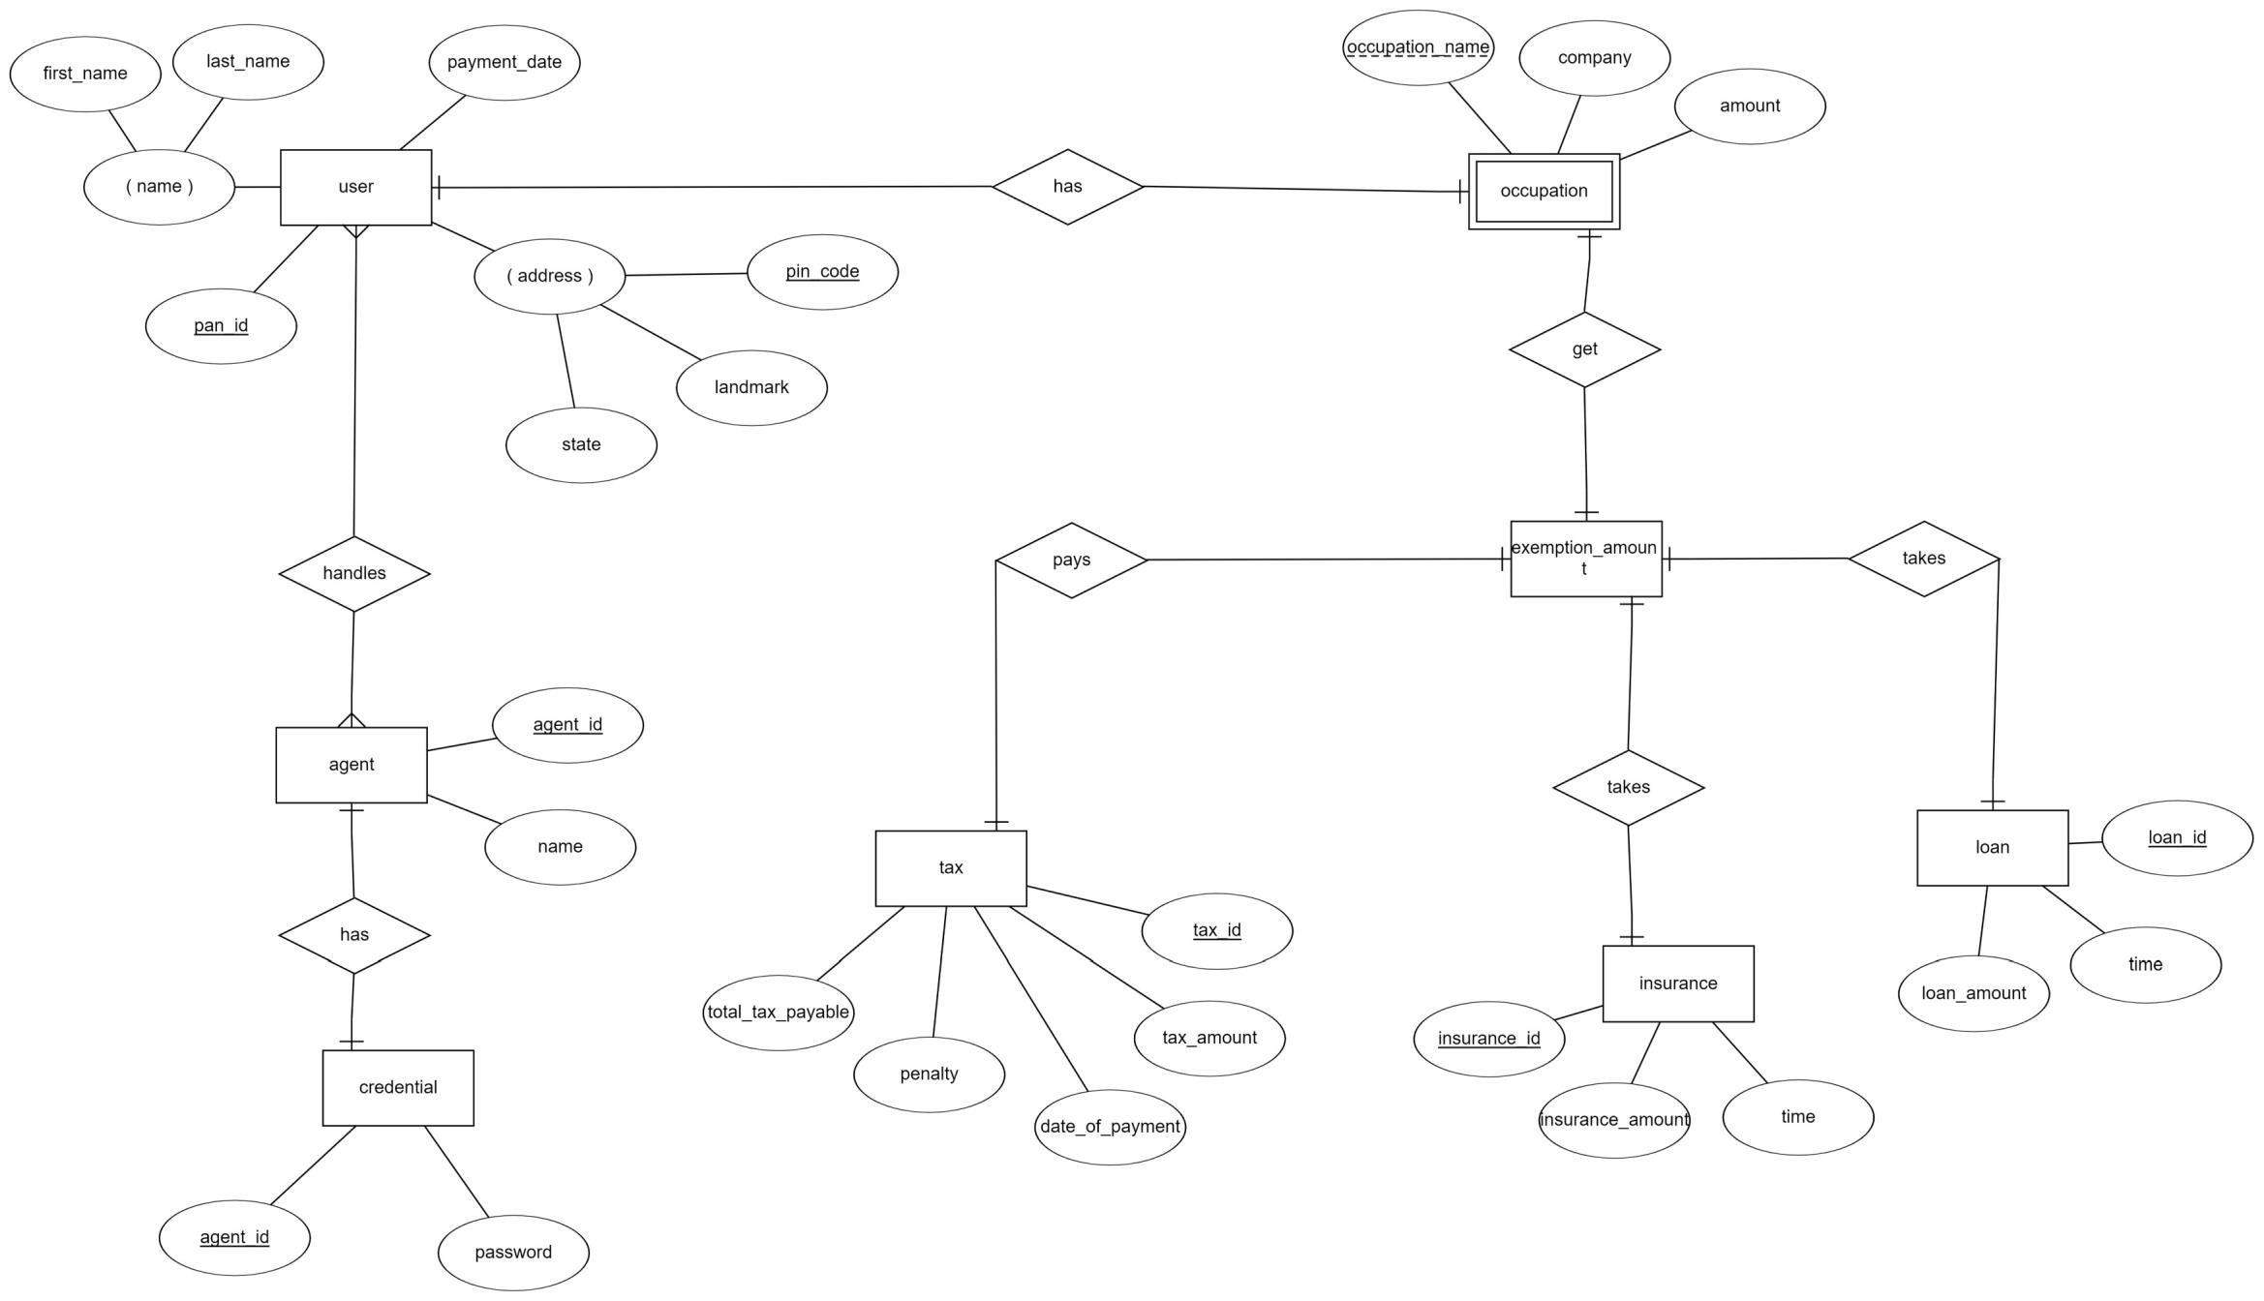
ER MODEL DIAGRAM

Slide 6
FD’s, Primary Key, Normalization
AGENT TABLE
FD’s : Agentid -> agentid, name
agentid is the primary key since it determines all the attributes
Since all attributes which are prime and non prime depend directly on key, therefore this table is in BCNF

Slide 7
FD’s, Primary Key, Normalization
CREDENTIAL TABLE
FD’s : agentid -> password
Since, agentid determines all attributes, its the primary key
Since all attributes which are prime and non prime depend directly on key, therefore this table is in BCNF

Slide 8
FD’s, Primary Key, Normalization
TAX TABLE
FD’s : Taxid -> totaltaxpayable, penality, dateofpayment, taxamount
taxid is the primary key since it determines all the attributes
Since all attributes which are prime and non prime depend directly on key, therefore this table is in BCNF

Slide 9
FD’s, Primary Key, Normalization
INSURANCE TABLE
FD’s : Insuranceid -> insuranceamount, time
insuranceid is the primary key since it determines all the attributes
Since all attributes which are prime and non prime depend directly on key, therefore this table is in BCNF

Slide 10
FD’s, Primary Key, Normalization
LOAN TABLE
FD’s : Loanid -> loanamount, time
loanid is the primary key since it determines all the attributes
Since all attributes which are prime and non prime depend directly on key, therefore this table is in BCNF

Slide 11
FD’s, Primary Key, Normalization
OCCUPATION TABLE
FD’s : Occupationname -> company, amount
occupationname is the primary key since it determines all the attributes
Since all attributes which are prime and non prime depend directly on key, therefore this table is in BCNF

Slide 12
FD’s, Primary Key, Normalization
USER TABLE
FD’s : Panid -> firstname, lastname, paymentdate, pincode, landmark, state
panid is the primary key since it determines all the attributes
Since all attributes which are prime and non prime depend directly on key, therefore this table is in BCNF

Slide 13
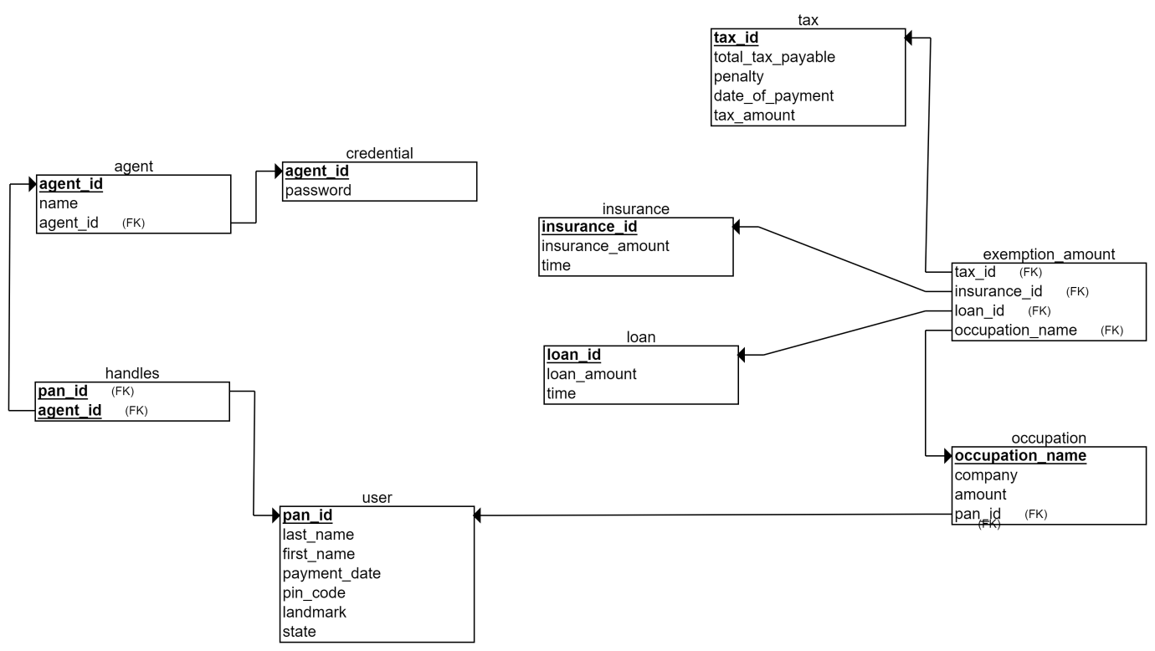
RELATIONAL DATABASE MODEL

Slide 14
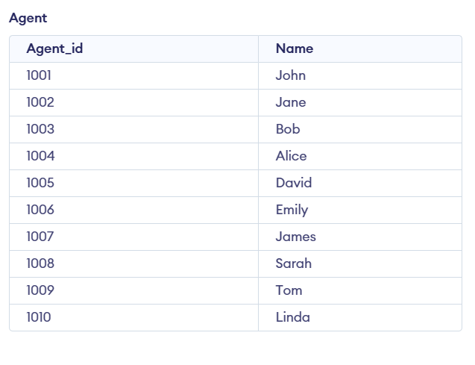
CREATION OF TABLES
AGENT TABLE
Create table agent( Agent id int, Name varchar(20), Agent_id int, Primary key (Agent_id) );

Slide 15
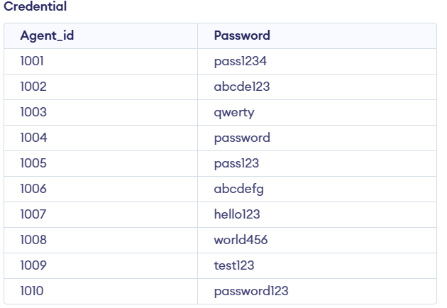
CREATION OF TABLES
CREDENTIAL TABLE
Create table credential( Agent_id int, Password varchar(20), Primary key (Agent_id) );

Slide 16
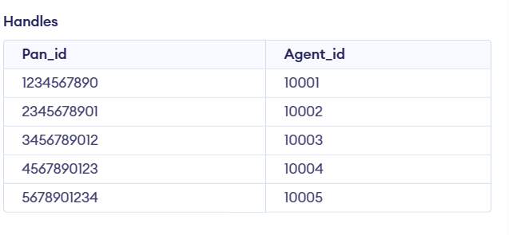
CREATION OF TABLES
HANDLES TABLE
Create table Handles( Pan_id int, Agent_id int );

Slide 17
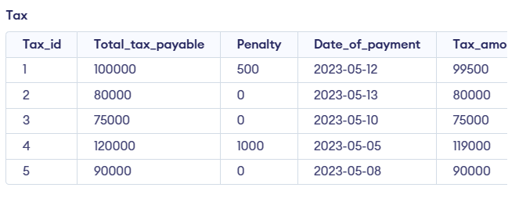
CREATION OF TABLES
TAX TABLE
Create table tax( Tax_id int, Total_tax_payable int, Penalty int, Date_of_payment date, Tax_amount int, Primary key(tax_id) );

Slide 18
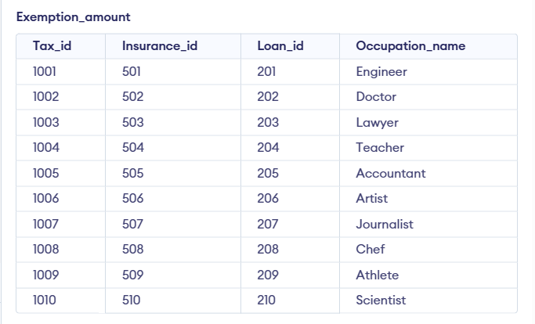
CREATION OF TABLES
EXEMPTION_AMOUNT TABLE
Create table Exemption_amount( Tax_id int, Insurance_id int , Loan_id int, Occupation_name varchar(20) );

Slide 19
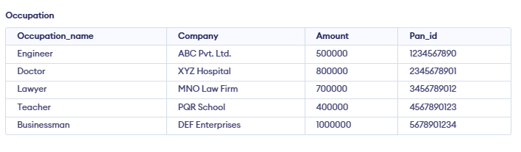
CREATION OF TABLES
OCCUPATION TABLE
Create table Occupation( Occupation_name varchar(20), Company varchar(20), Amount int, Pan_id int , Primary key(occupation_name) );

Slide 20
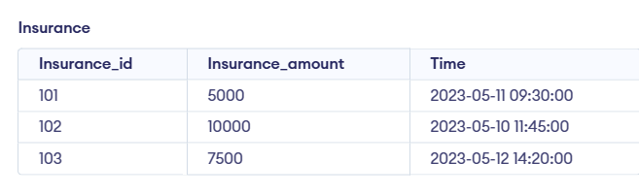
CREATION OF TABLES
INSURANCE TABLE
Create table insurance( Insurance_id int, Insurance_amount int, Time timestamp, Primary key(Insurance_id) );

Slide 21
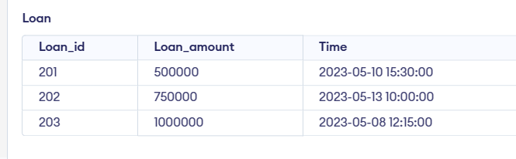
CREATION OF TABLES
LOAN TABLE
Create table loan ( Loan_id int, Loan_amount int, Time timestamp, Primary key(Loan_id) );

Slide 22
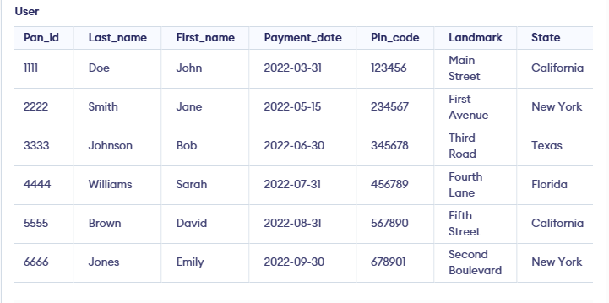
CREATION OF TABLES
USER TABLE
Create table user( Pan_id int, Last_name varchar(20), First_name varchar(20), Payment_date date, Pin_code int, Landmark varchar(20), State int, Primary key(Pan_id) );

Slide 23
INSERTION OF VALUES IN TABLE
AGENT TABLE
INSERT INTO agent (Agent_id, Name) VALUES (1001, 'John'), (1002, 'Jane'), (1003, 'Bob'), (1004, 'Alice'), (1005, 'David'), (1006, 'Emily'), (1007, 'James'), (1008, 'Sarah'), (1009, 'Tom'), (1010, 'Linda');
CREDENTIAL TABLE
INSERT INTO credential (Agent_id, Password) VALUES (1001, 'pass1234'), (1002, 'abcde123'), (1003, 'qwerty'), (1004, 'password'), (1005, 'pass123'), (1006, 'abcdefg'), (1007, 'hello123'), (1008, 'world456'), (1009, 'test123'), (1010, 'password123');

Slide 24
INSERTION OF VALUES IN TABLE
HANDLES TABLE
INSERT INTO Handles (Pan_id, Agent_id) VALUES (1234567890, 10001), (2345678901, 10002), (3456789012, 10003), (4567890123, 10004), (5678901234, 10005);
TAX TABLE
INSERT INTO tax (Tax_id, Total_tax_payable, Penalty, Date_of_payment, Tax_amount) VALUES (1, 100000, 500, '2023-05-12', 99500), (2, 80000, 0, '2023-05-13', 80000), (3, 75000, 0, '2023-05-10', 75000), (4, 120000, 1000, '2023-05-05', 119000), (5, 90000, 0, '2023-05-08', 90000);

Slide 25
INSERTION OF VALUES IN TABLE
EXEMPTION_AMOUNT TABLE
INSERT INTO exemption_amount (Tax_id, Insurance_id, Loan_id, Occupation_name) VALUES (1001, 501, 201, 'Engineer'), (1002, 502, 202, 'Doctor'), (1003, 503, 203, 'Lawyer'), (1004, 504, 204, 'Teacher'), (1005, 505, 205, 'Accountant'), (1006, 506, 206, 'Artist'), (1007, 507, 207, 'Journalist'), (1008, 508, 208, 'Chef'), (1009, 509, 209, 'Athlete'), (1010, 510, 210, 'Scientist');
OCCUPATION TABLE
INSERT INTO Occupation (Occupation_name, Company, Amount, Pan_id) VALUES ('Engineer', 'ABC Pvt. Ltd.', 500000, 1234567890), ('Doctor', 'XYZ Hospital', 800000, 2345678901), ('Lawyer', 'MNO Law Firm', 700000, 3456789012), ('Teacher', 'PQR School', 400000, 4567890123), ('Businessman', 'DEF Enterprises', 1000000, 5678901234);

Slide 26
INSERTION OF VALUES IN TABLE
INSURANCE TABLE
INSERT INTO insurance (Insurance_id, Insurance_amount, Time) VALUES (101, 5000, '2023-05-11 09:30:00'), (102, 10000, '2023-05-10 11:45:00'), (103, 7500, '2023-05-12 14:20:00');
LOAN TABLE
INSERT INTO loan (Loan_id, Loan_amount, Time) VALUES (201, 500000, '2023-05-10 15:30:00'), (202, 750000, '2023-05-13 10:00:00'), (203, 1000000, '2023-05-08 12:15:00');
USER TABLE
INSERT INTO user (Pan_id, Last_name, First_name, Payment_date, Pin_code, Landmark, State) VALUES (1111, 'Doe', 'John', '2022-03-31', 123456, 'Main Street', 'California’), (2222, 'Smith', 'Jane', '2022-05-15', 234567, 'First Avenue', 'New York’), (3333, 'Johnson', 'Bob', '2022-06-30', 345678, 'Third Road', 'Texas’), (4444, 'Williams', 'Sarah', '2022-07-31', 456789, 'Fourth Lane', 'Florida'), (5555, 'Brown', 'David', '2022-08-31', 567890, 'Fifth Street', 'California’), (6666, 'Jones', 'Emily', '2022-09-30', 678901, 'Second Boulevard', 'New York');

Slide 27
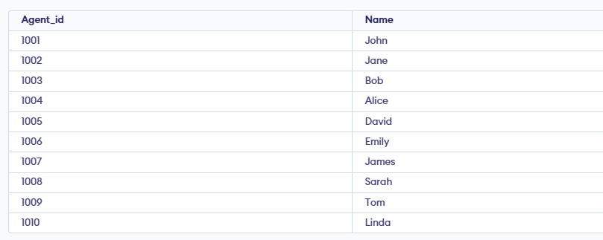
SQL QUERIES
OUTPUT →
Select all agents and their names: SELECT Agent_id, Name FROM agent;

Slide 28
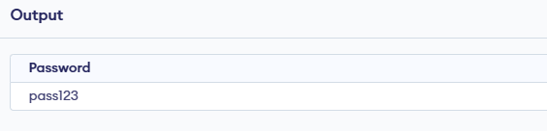
SQL QUERIES
OUTPUT →
Select the password for a specific agent: SELECT Password FROM credential WHERE Agent_id = 1005;

Slide 29
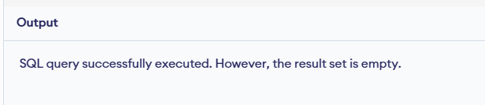
SQL QUERIES
OUTPUT →
Select all the pan IDs handled by a specific agent: SELECT Pan_id FROM Handles WHERE Agent_id = 1002;

Slide 30
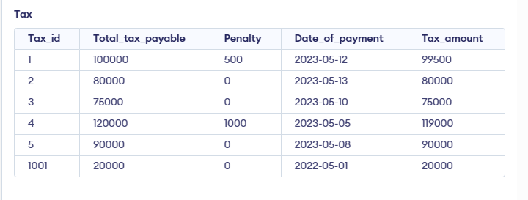
SQL QUERIES
OUTPUT →
Insert a new tax payment record: INSERT INTO tax (Tax_id, Total_tax_payable, Penalty, Date_of_payment, Tax_amount) VALUES (1001, 20000, 0, '2022-05-01', 20000);

Slide 31
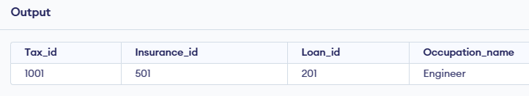
SQL QUERIES
OUTPUT →
Select the exemption amounts for a specific tax ID: SELECT * FROM Exemption_amount WHERE Tax_id = 1001;

Slide 32

SQL QUERIES
OUTPUT →
Select the occupation details for a specific PAN ID: SELECT * FROM Occupation WHERE Pan_id = 123456789;

Slide 33
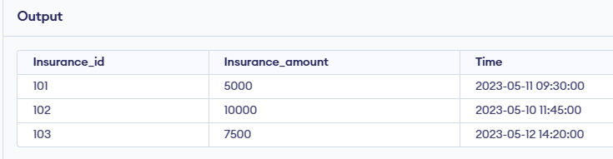
SQL QUERIES
OUTPUT →
Select all insurance records: SELECT * FROM insurance;

Slide 34
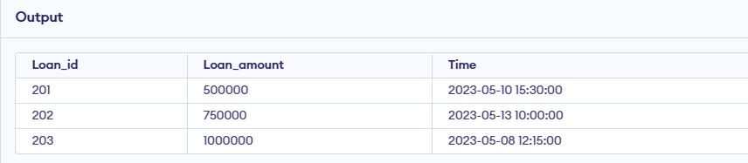
SQL QUERIES
OUTPUT →
Select all loans with a loan amount greater than 50000: SELECT * FROM loan WHERE Loan_amount > 50000;

Slide 35
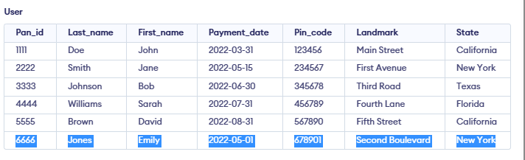
SQL QUERIES
OUTPUT →
Update the payment date for a specific user: UPDATE user SET Payment_date = '2022-05-01' WHERE Pan_id = 6666;

Slide 36
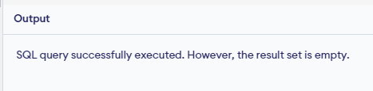
SQL QUERIES USING JOIN
OUTPUT →
Select the name and tax amount for all taxpayers along with their exemption amounts: SELECT u.First_name, u.Last_name, t.Tax_amount, e.Insurance_id, e.Loan_id, e.Occupation_name FROM user u INNER JOIN Exemption_amount e ON u.Pan_id = e.Tax_id INNER JOIN tax t ON t.Tax_id = e.Tax_id;

Slide 37
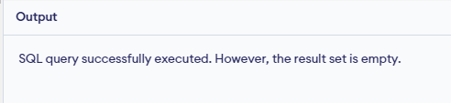
SQL QUERIES USING JOIN
OUTPUT →
Select the name and loan amount for all users who have taken loans, along with the time of the loan and the insurance ID associated with the loan: SELECT u.First_name, u.Last_name, l.Loan_amount, l.Time, e.Insurance_id FROM user u INNER JOIN Exemption_amount e ON u.Pan_id = e.Tax_id INNER JOIN loan l ON e.Loan_id= l.Loan_id;

Slide 38

SQL QUERIES USING JOIN
OUTPUT →
Select the name and tax amount for all taxpayers who have paid their taxes, along with the penalty associated with the payment: SELECT u.First_name, u.Last_name, t.Tax_amount, t.Penalty FROM user u INNER JOIN tax t ON u.Pan_id = t.Tax_id WHERE t.Date_of_payment IS NOT NULL;

Slide 39
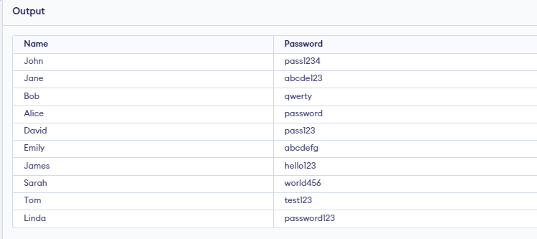
SQL QUERIES USING JOIN
OUTPUT →
Retrieve the agent name and their password: SELECT a.Name, c.Password FROM agent a JOIN credential c ON a.Agent_id = c.Agent_id;

Slide 40
CONCLUSION
Thus, we created the database model of TAX management system and were able to conclude this using the various data's that we could thought of in a practical way. Hoping this project would help us in our future with the way of developing a full functional application based Data model in a bigger format.

